Slide 1

EDFLIX
Adalarasu, Ananyaa
Chen, Juntao
Huang, Lucas Jiaye
Lin, Qitao
Tisdall, Niamh
Zhou, Stan Ziyao

Slide 2
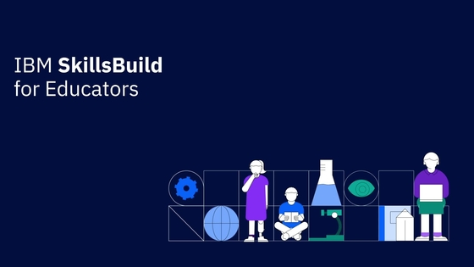
Our Client

Slide 3
Aims
Front end video streaming style wrapper
AI supported recommendation system
Comments and rating systems

Slide 4
Deliverables
Web based user interface
SQL Database storing user and usage data
Visualization of collected data
IBM Watson AI
GitHub storing all code and data accessible by development team,
Durham University, and IBM

Slide 5
Introduction
Our client, Aims, Deliverables
Project Development
Software development framework
01
03
Technical Outline
Communication between systems,
Data flow, Front end, Back end,
Potential features
Future Plan
Weekly plan, Tasks for sub teams,
Work before and after test plan
04
02

Slide 6
Technical Outline
A detailed design of the software

Slide 7
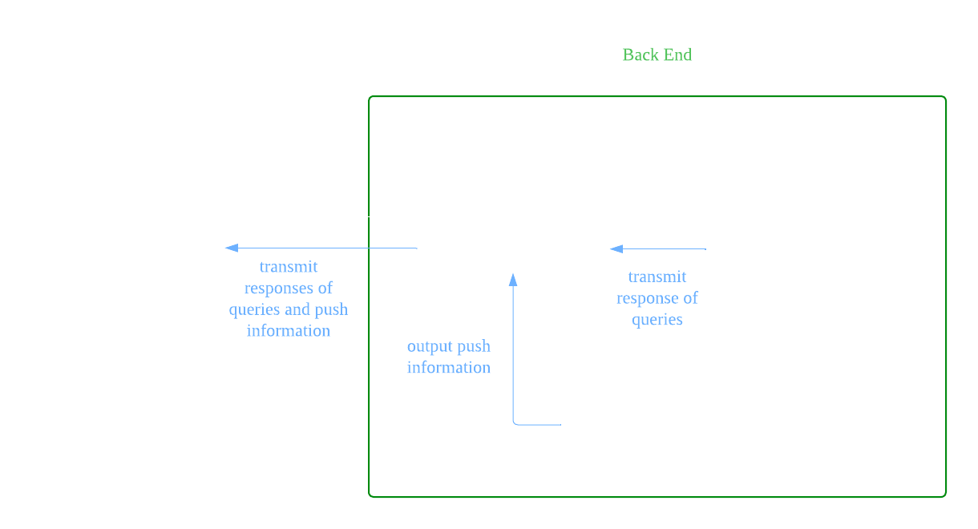
Communication between Systems

Slide 8
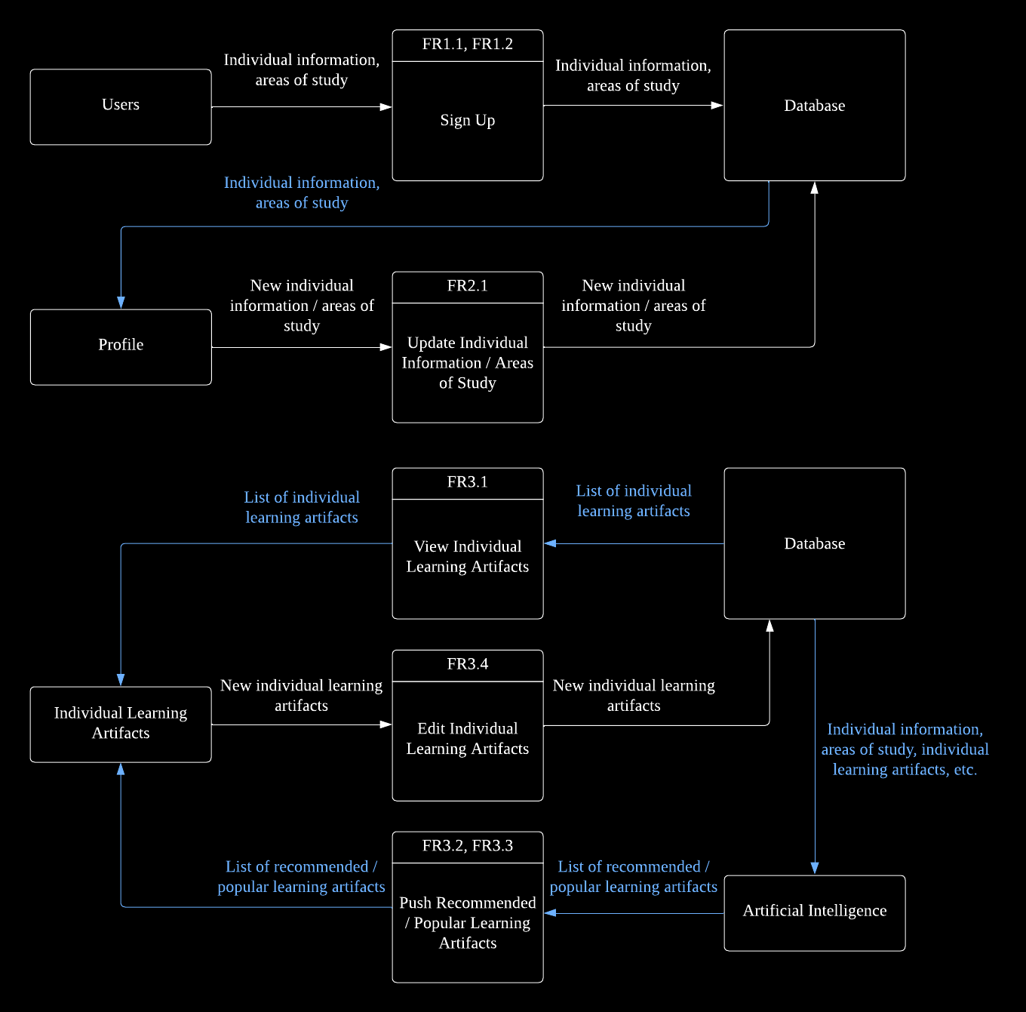
Data Flow

Slide 9
Data Flow

Slide 10
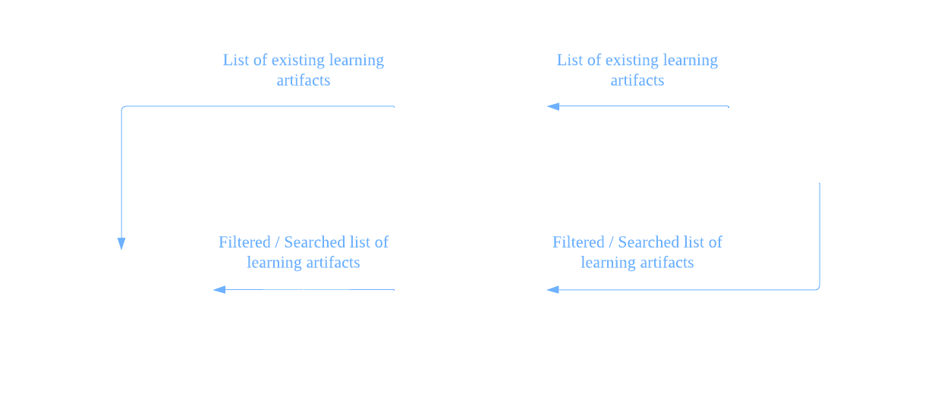
Data Flow

Slide 11
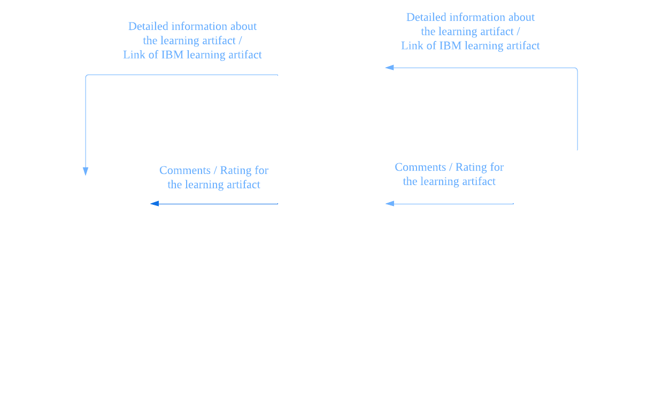
Data Flow

Slide 12
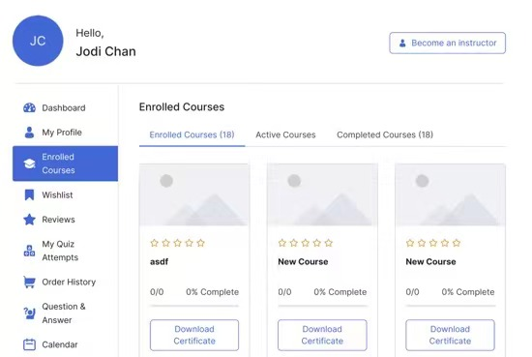
Front End

Slide 13
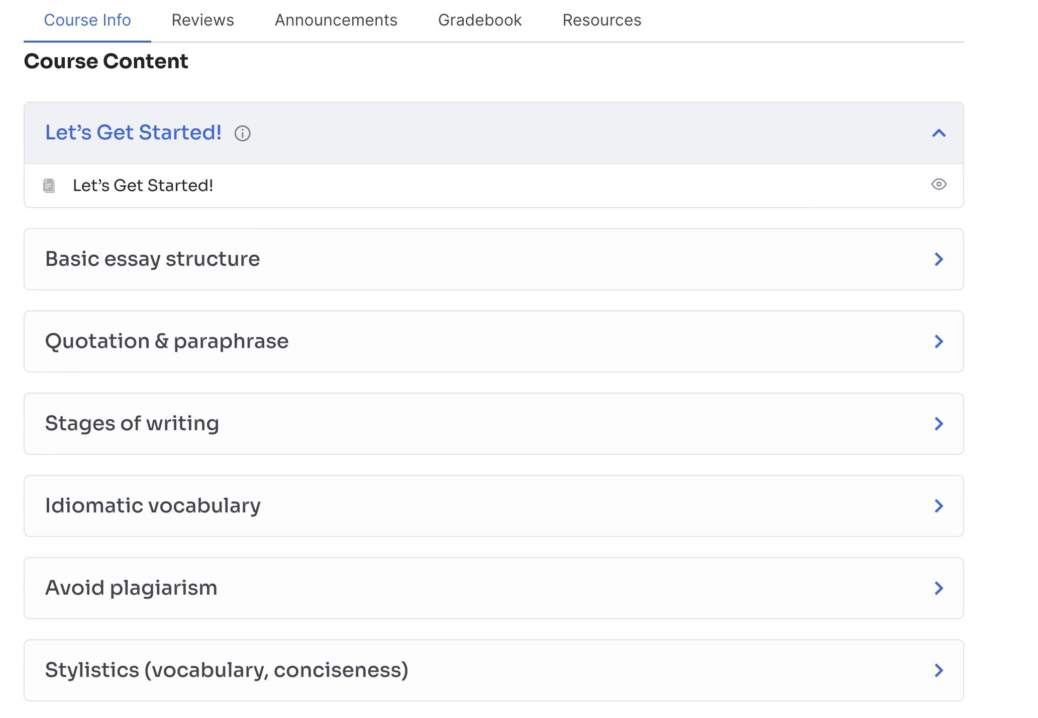
Front End

Slide 14
Back End – RESTful API
Standard HTTP Method | ID | Functional Requirements
GET | FR3.1 | View individual learning artifacts
 | FR3.2, FR3.2 | Push recommended / popular learning artifacts
 | FR4.1 | View existing learning artifacts
 | FR4.2, FR4.3 | Filter / Search learning artifact(s)
 | FR5.1 | View information about the learning artifact
 | FR5.2, FR5.3 | View comment / rating for the learning artifact
 | FR5.4 | Link to IBM learning artifact
POST | FR1.1, FR1,2 | Sign up
 | FR5.2 | Create comment for the learning artifact
PATCH | FR2.1 | Update individual information / area(s) of study
 | FR3.4 | Edit individual learning artifacts
 | FR5.3 | Add rating for the learning artifact
DELETE | FR2.3 | Delete account

Slide 15
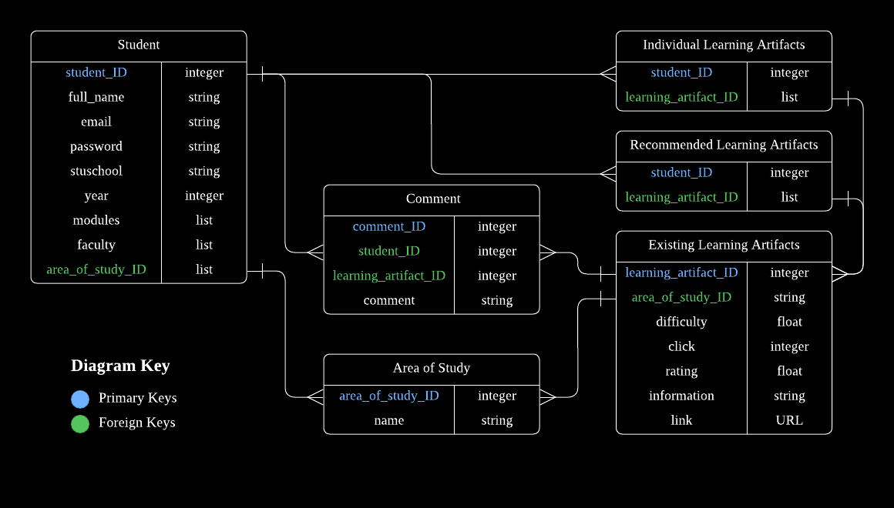
Back End – Database

Slide 16
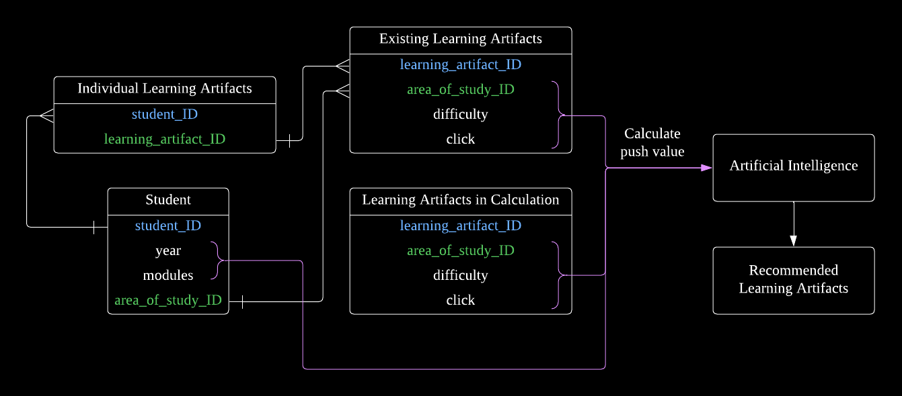
Back End – AI

Slide 17
Potential Features
HTTP cookies
save essential user information for future use
AI
high-dimensional portrait of the user
Database
automatic addition and deletion of the learning artifacts and their corresponding resources
web crawling and advanced database querying

Slide 18
Project Development
Chosen process for the software development

Slide 19
Software Development Process
Dynamic System Development Method (DSDM)
Pre-planned time boxes
Intermediary meeting
Functionality check against requirements
Review of work

Slide 20
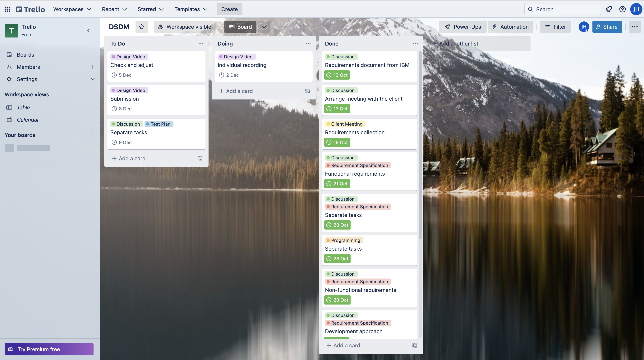
Trello

Slide 21
Future Plan
Tasks to do next, before and after the test plan

Slide 22
Future Plan
Weekly
Meeting
Progress report from each group member
Potential risk and issues monitor
Software
Front end, database, AI
Document
Content of test plan

Slide 23
Future Plan
Before submission of test plan
First release of the software
High priority functionalities
After submission of test plan
More release of the software
Medium and low priority functionalities
Potential features
Functional and non-functional standard test and adjust
Product handover

Slide 24
Thank you

